Slide 1

Physiology and Nutrition
Division Day
As part of the networking session which will run on the morning of the division day, we would like all attendees to complete two PowerPoint slides about themselves.
We have provided a template for you to complete below, along with an example of two completed slides.

Slide 2
Name email address
Inset photo
of yourself
here
Current role and organisation:
…
Areas of interest:
…
…
…
Current work:
…
…
…

Slide 3
Name email address
Inset photo
of yourself
here
Links with academia and/or industry:
…
…
What support do you need from BASES members……..
…
An interesting fact about me:
…

Slide 4
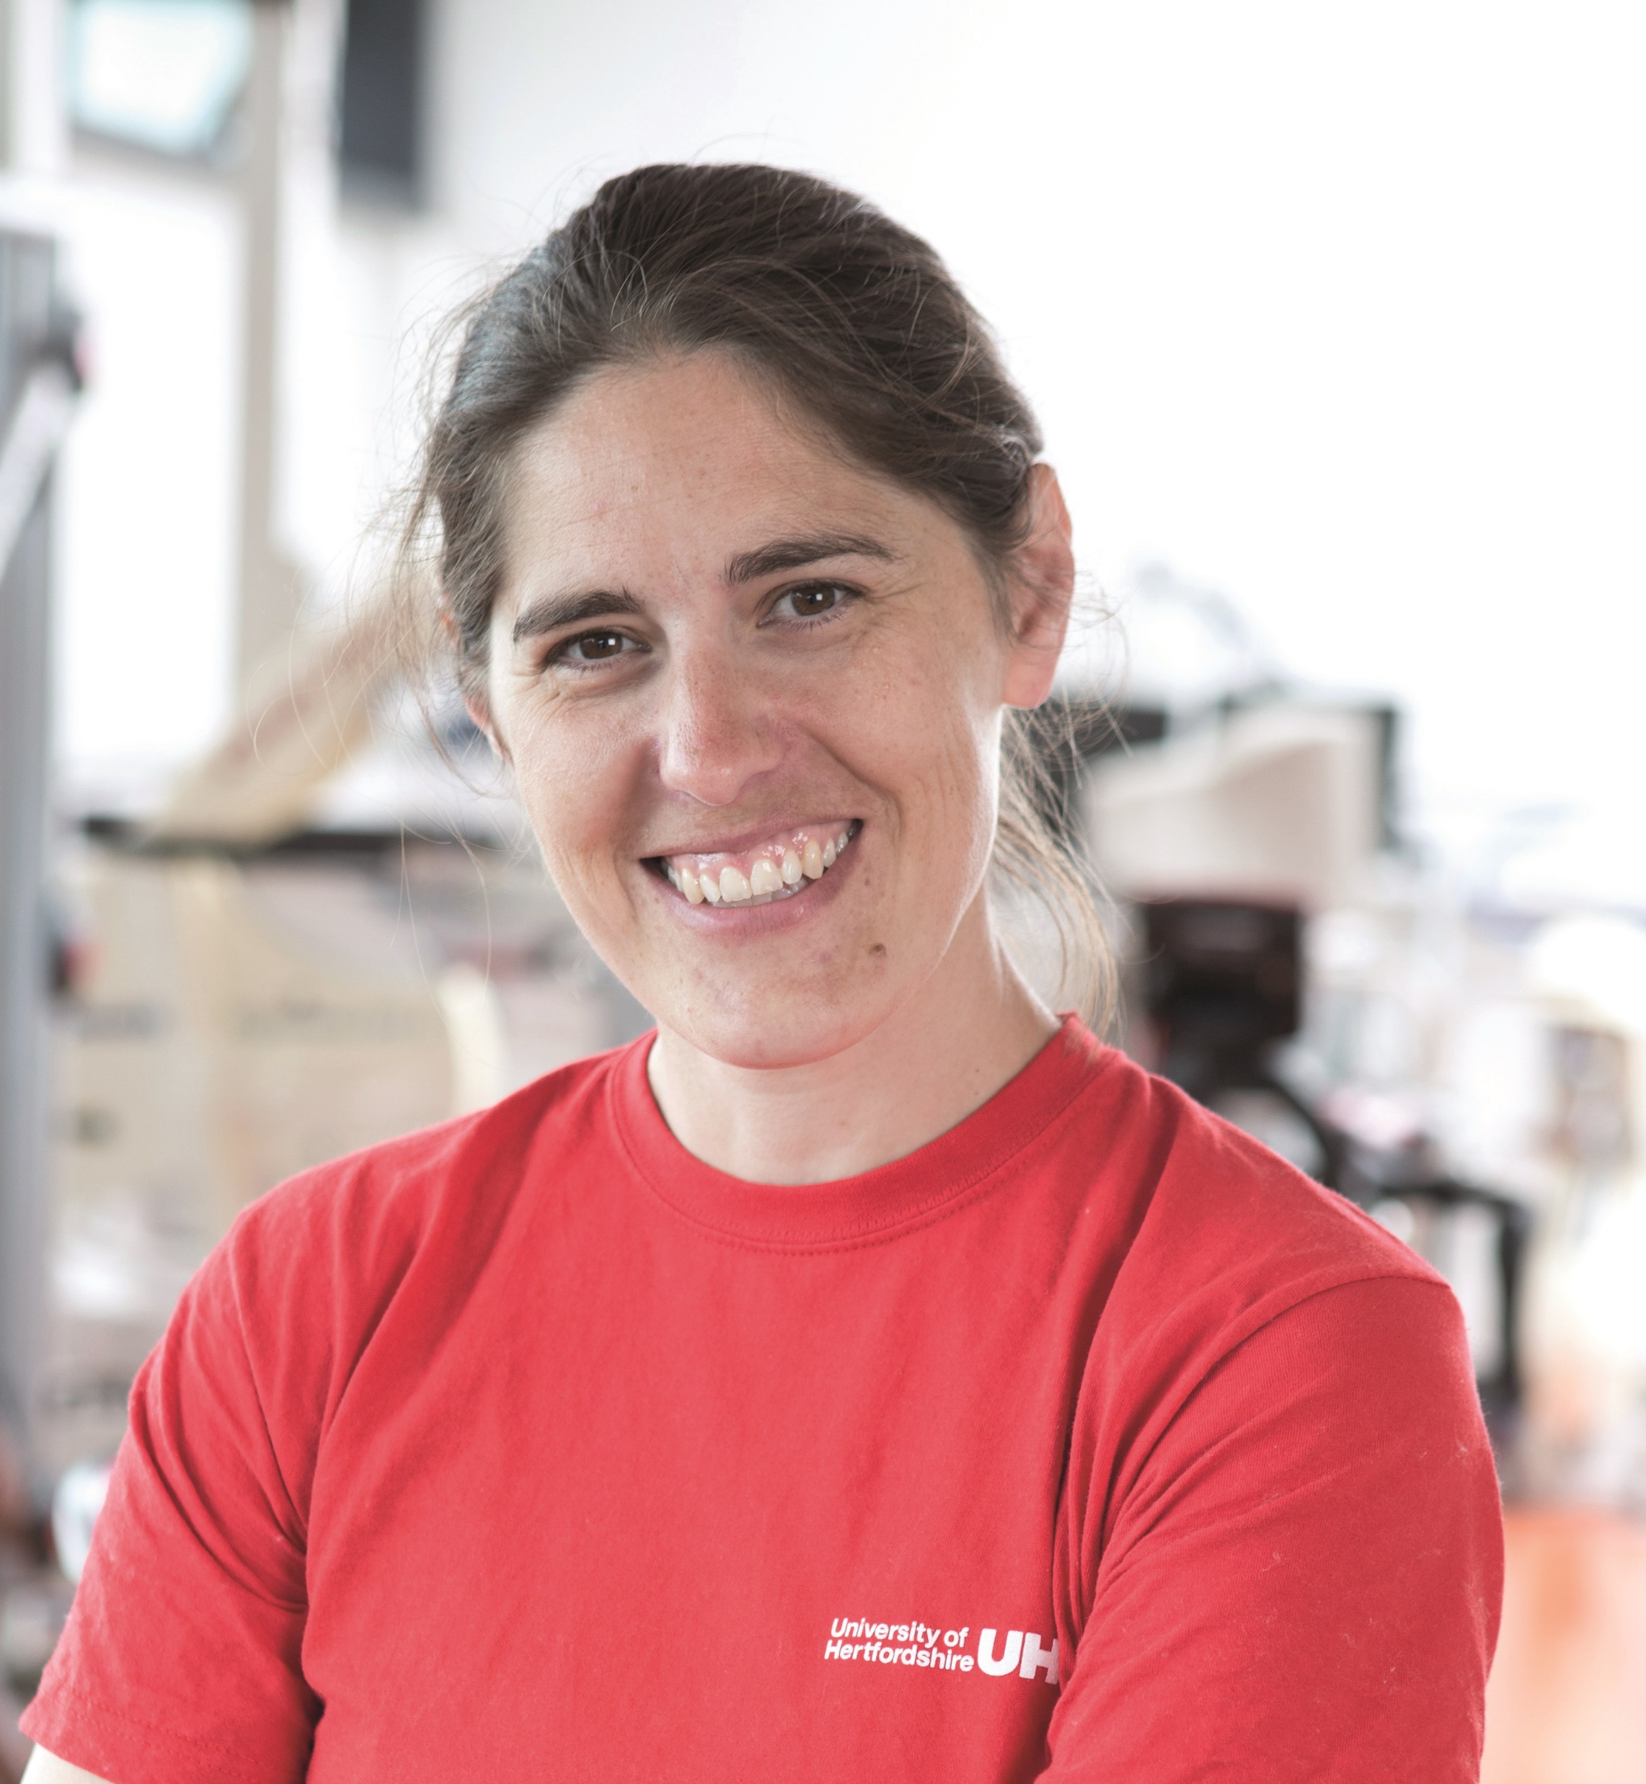
Dr Lindsay Bottoms l.bottoms@Herts.ac.uk
Current role and organisation:
Head of Centre for Research in Psychology and Sports Science, Reader in Exercise and Health Physiology, University of Hertfordshire, May 2015 - present
Areas of interest:
Physical activity for different chronic health conditions such as inflammatory bowel disease and mental health
Nutritional supplementation for performance and health
Fencing performance
Current work:
High intensity vs low intensity exercise for depressed young people
Exercise for alcohol addiction
Home based exercise for diabetes in Saudi Arabia
Trans women participation in fencing

Slide 5
Dr Lindsay Bottoms l.bottoms@Herts.ac.uk
Links with academia (if practitioner) or industry (if academic):
Digital Wellbeing
Fencing equipment supplier
What support do you need from BASES members……..
Collaborations
An interesting fact about me:
I was the youngest person in the country to get a black belt in Shotokan Karate in 1993

